Slide 1
More on Neural Nets (Tensorflow)
Andrew Beatty
Andrew.Beatty@gmit.ie
Programming for cybersecurity

Slide 2
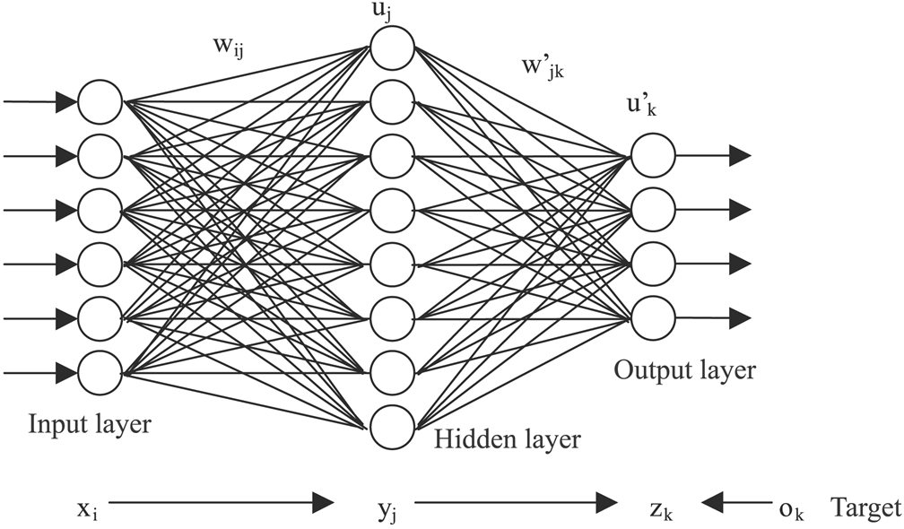
Last week
Inspired by the brain,
Used for pattern matching,
They get trained.
Dense Neural nets

Slide 3
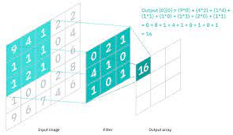
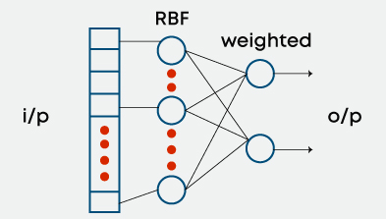
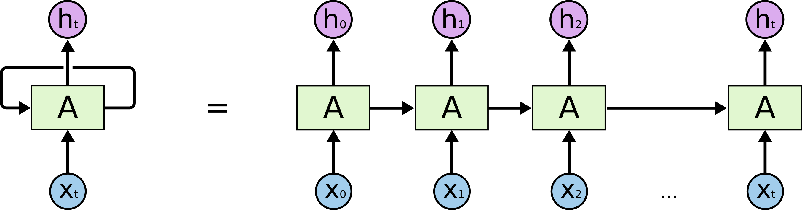
Lots of different architectures
Simple (dense, feed forward, perceptron)
convolutional neural network
Radial basis Neural networks
Recurrent Neural Networks (RNN)
And more

Slide 4
Other concepts/techiques
Date augmentation
Using pretrained datasets
Saving models
Word embedding (encoding)

Slide 5
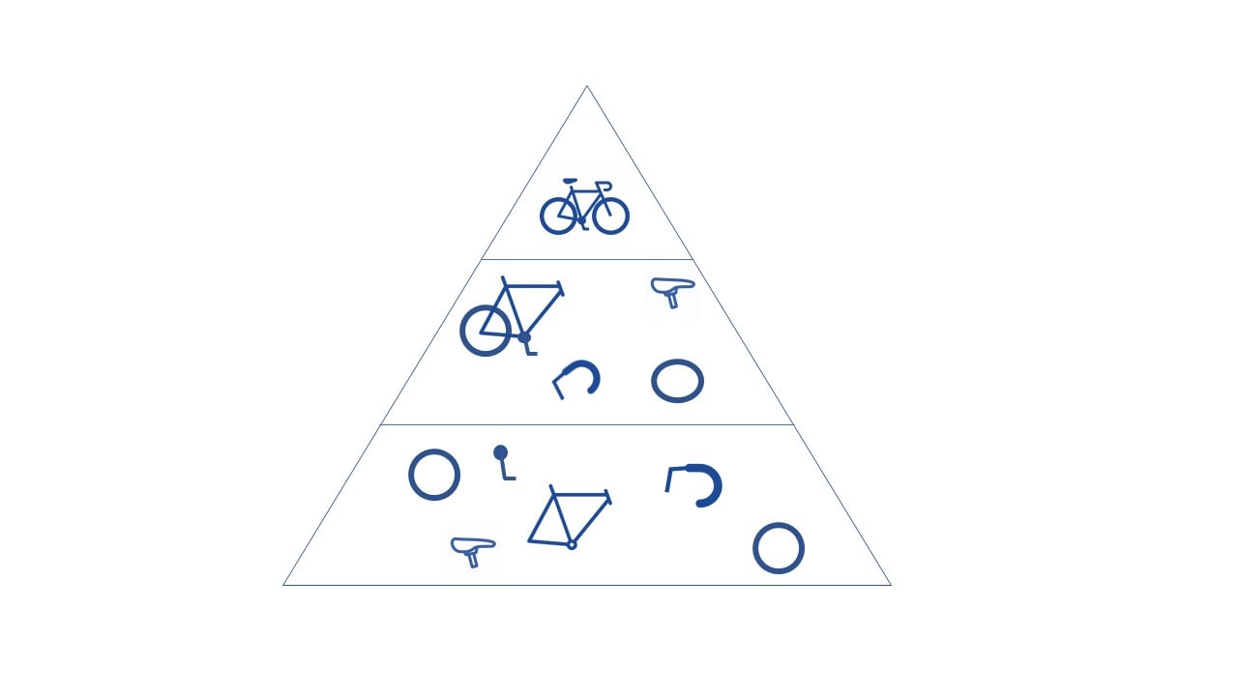
convolutional neural network
Good at finding features

Slide 6
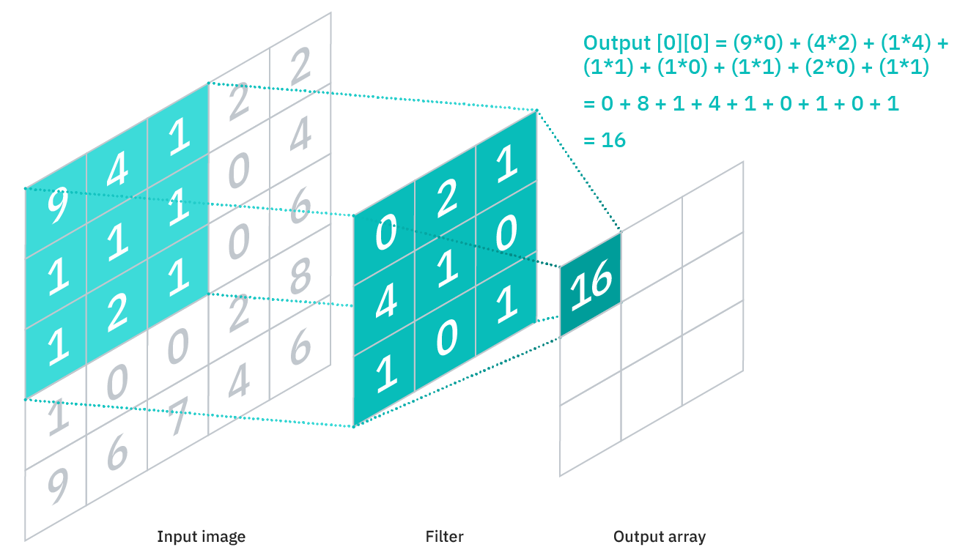
LAYERS
Convolutional Layer
Number of filters
Stride
Zero padding
Pooling Layer
While a lot of information is lost in the pooling layer, it also has a number of benefits to the CNN. They help to reduce complexity, improve efficiency, and limit risk of overfitting
Max pooling
Average pooling
Full Connected Layer
The dense layer

Slide 7
Code
model = models.Sequential()
model.add(layers.Conv2D(32, (3, 3), activation='relu', input_shape=(32, 32, 3)))
model.add(layers.MaxPooling2D((2, 2)))
model.add(layers.Conv2D(64, (3, 3), activation='relu'))
model.add(layers.MaxPooling2D((2, 2)))
model.add(layers.Conv2D(64, (3, 3), activation='relu’))
model.add(layers.Flatten())
model.add(layers.Dense(64, activation='relu'))
model.add(layers.Dense(10))

Slide 8
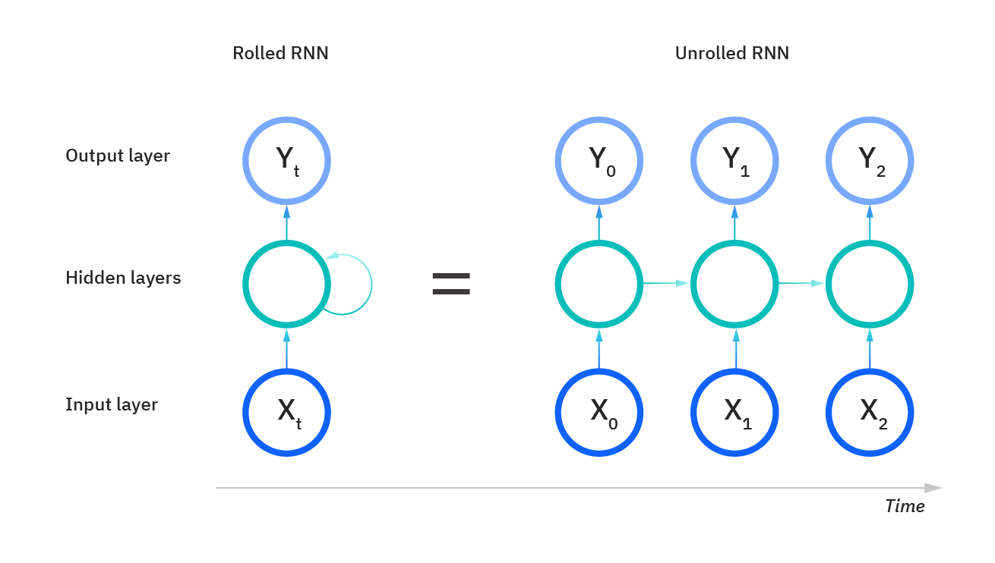
Recurrent Neural Networks (RNN)
Take the output from the last run and pass it into the next run
Lots of types of course.

Slide 9
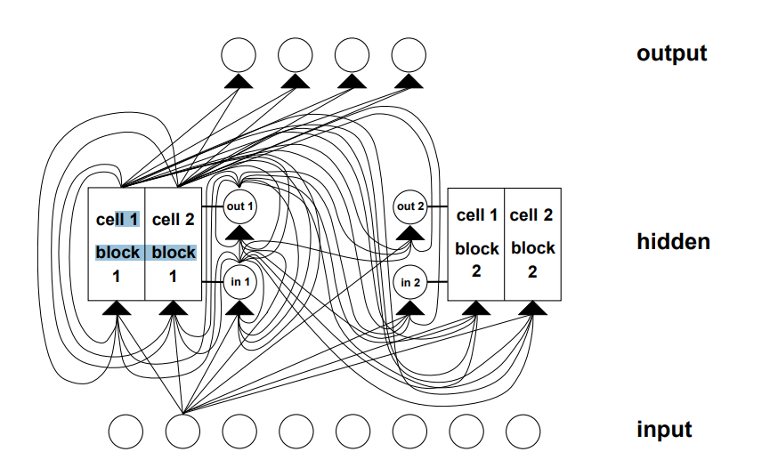
Other types
Bidirectional recurrent neural networks (BRNN):
Long short-term memory (LSTM):
Gated recurrent units (GRUs):

Slide 10
Code
model = tf.keras.Sequential([
tf.keras.layers.Embedding(VOCAB_SIZE, 32),
tf.keras.layers.LSTM(32),
tf.keras.layers.Dense(1, activation="sigmoid")
])

Slide 11
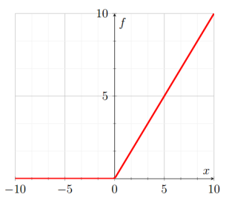
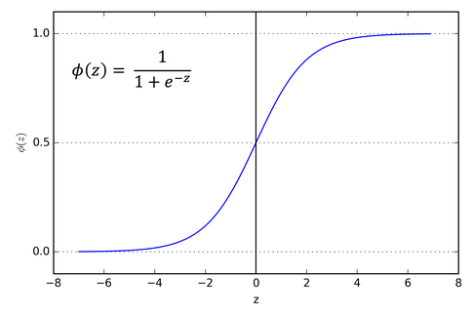

Relu
Sigmund

Slide 12
Lets look at the code

